Slide 1
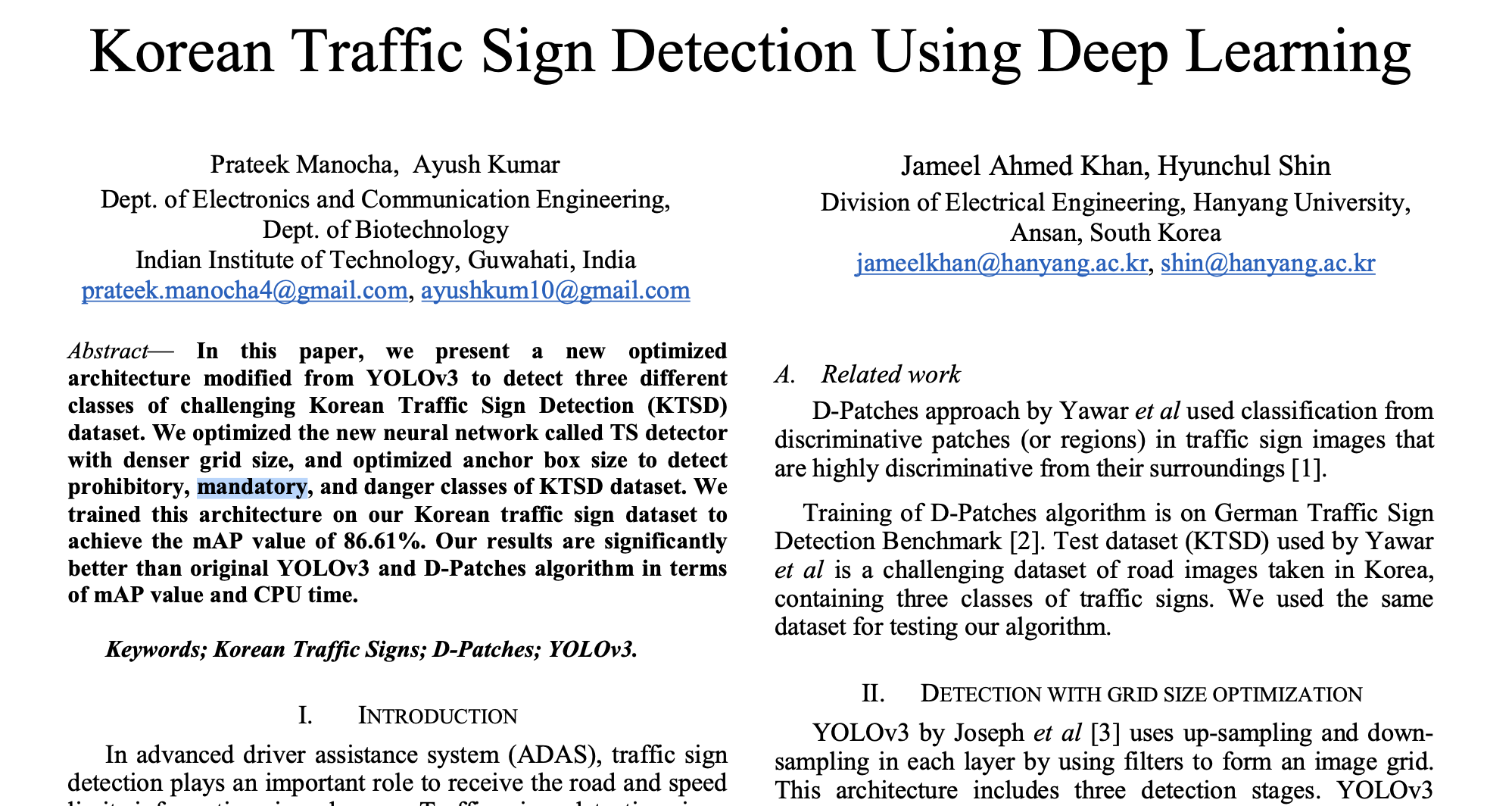
3. Reference Paper
https://ieeexplore.ieee.org/document/8649887

Slide 2
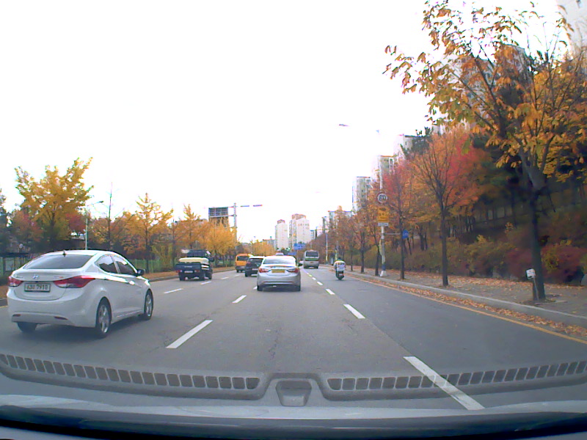
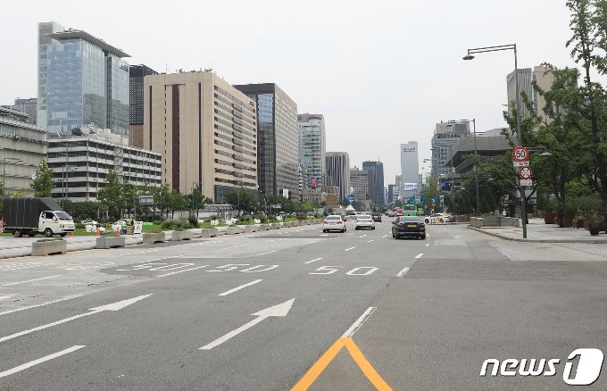
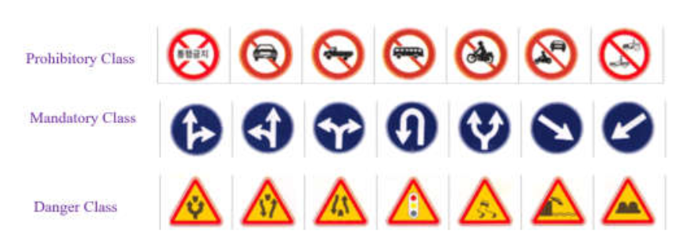
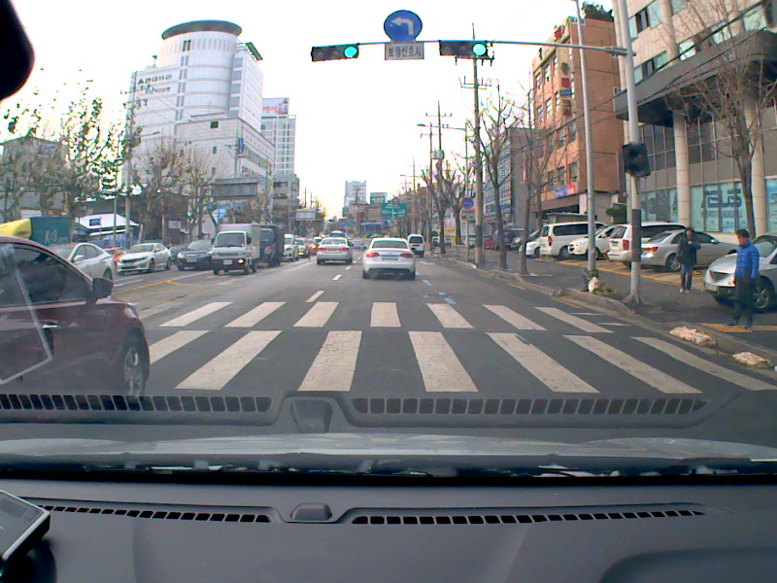
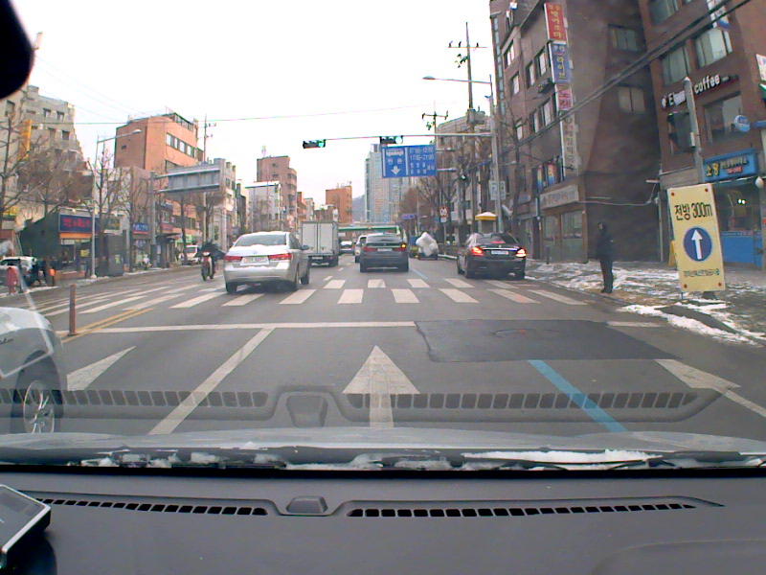
3. Reference Paper
Korean Traffic Sign Dataset
Korean Traffic Sign Classes
Training

Slide 3
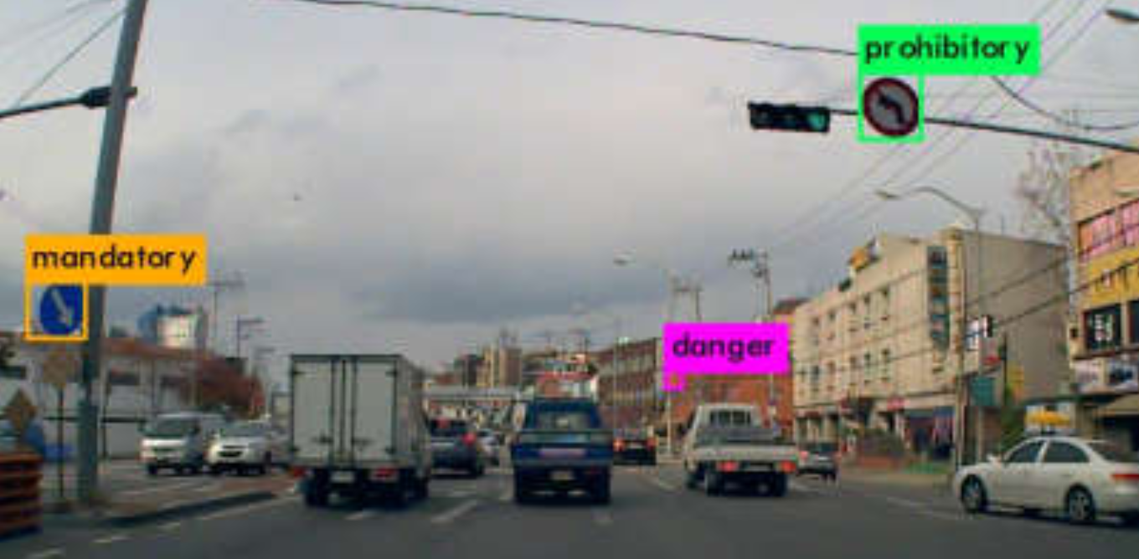
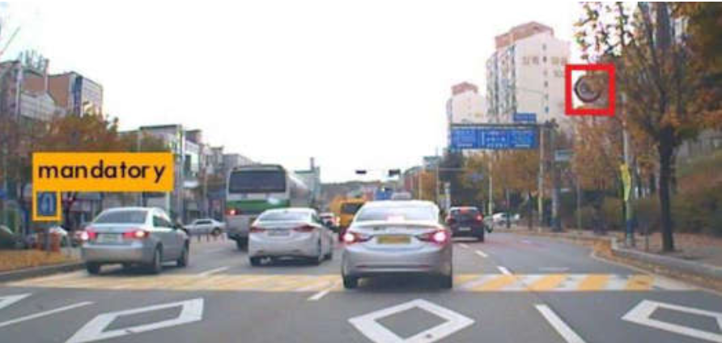
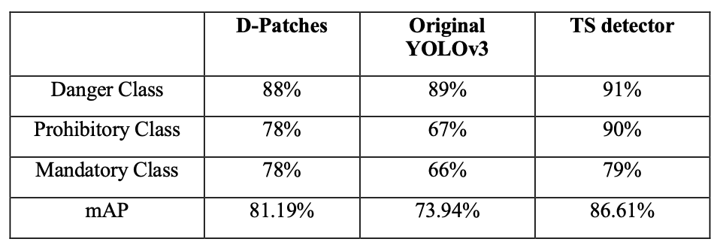
3. Reference Paper

Slide 4

3. Reference Paper
Korean Traffic Sign Dataset
Korean Traffic Sign Classes
Training with .

